Slide 1

How and why the FE matters in Wales
Julie Froud, Colin Haslam, Sukhdev Johal, Nick Tsitsianis, Karel Williams

Slide 2

The precondition: think of a zonal economy
Economics adds everything (marketable) up into GDP/ GVA
FE approach is to think of the economy as different zones with varied activity
Core
Material
Providential
Overlooked
Tradeable

Slide 3
Zonal Economy? what’s in the zones
Foundational Economy includes:
Material the pipes and cables, networks and branches which continuously connect households to daily essentials; now often privatised.
Providential foundational economy: a subset of (mainly) public sector welfare activity providing the universal services available to all citizens; now increasingly outsourced.
Overlooked economy: goods and services culturally defined as essential and requiring occasional purchase, for example, the sofa for your house, the holiday from work etc.
Tradable: agents and intermediaries involved in retail and wholesale activity, financial services, renting and leasing of equipment, business services and commercial real estate and development services, car manufacture.

Slide 4

GDP focuses on individual consumption and high productivity industries in the tradeable zone
Privileging of individual consumption; because consumption accounts for 60% of GDP + the quickest way of buying GDP growth is via consumption booms
Preoccupation with high productivity industries of the future + the tradeable; which is a small part of the Welsh economy ..30% in terms of employment in 2016

Slide 5
Zonal issue = how and why the FE matters
How
its a large part of the economy
its a stabilising part of the economy
Why
output is essential services
engine of distribution through wages
reservoir of skills we need
sphere of social innovation
unsolved problems and impending change

Slide 6
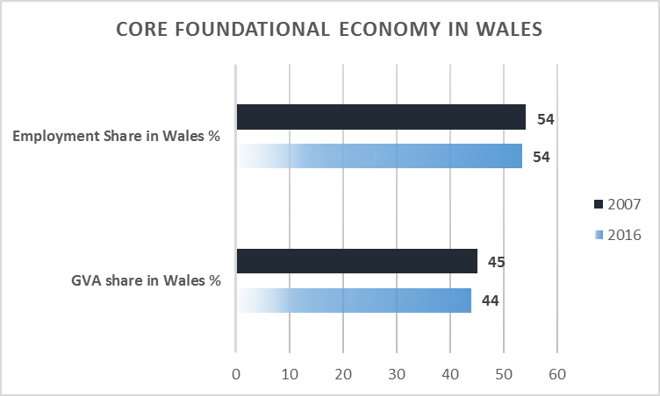
How (1) Because its a large part of the economy
Material and providential share of GVA 45% and share of employment in Wales 54%

Slide 7
How (2) Because it’s the stabiliser + equaliser in the economy
2007-2016 Austerity hasn’t shrunk it; Brexit doesn’t threaten
Resilient against structural and cyclical change because it is distributed according to population e.g. health and care or buses and food …as long as you retain the population
And the great equaliser of regions as long as education, health, BT, rail franchises pay much the same.

Slide 8
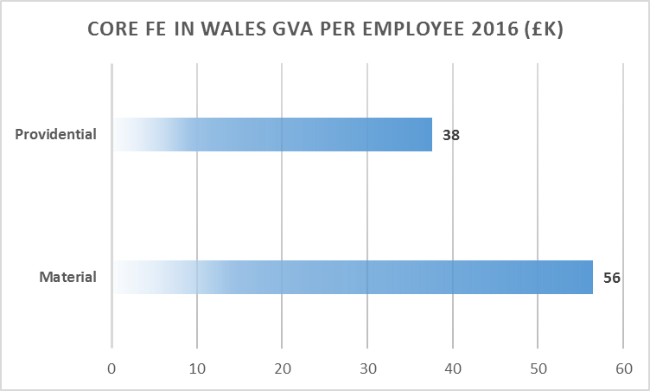
But FE activities are a mixed bag
Mixed bag /heterogeneous: the activities have different physical and financial characteristics
Centre for cities is wrong about “local services” are all low productivity
Productivity/ GVA per employee: higher in material than providential
So, what unites FE activities and why do they matter?

Slide 9
Why (1) FE output is essential services for households
Economics: all output is commensurable because it has a money value - GDP/ GVA calculated by addition
FE focuses on a special category of output: essential services where interruption of supply causes immediate crisis (power cuts, unsafe hospitals etc.)
The basis of everyday civilised life = a kind of special output different from fast fashion or a new smart phone

Slide 10
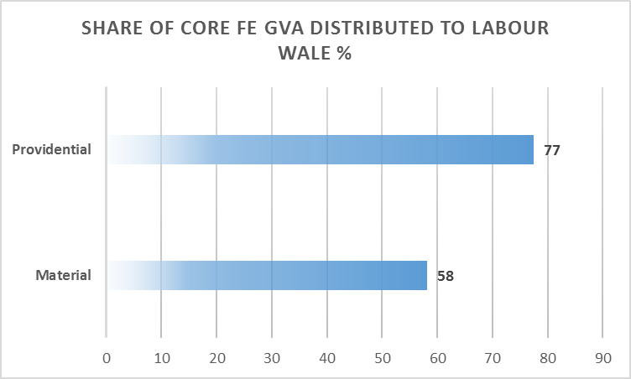
Why (2) engine of distribution through wages
Economics tends to assume high productivity sectors pay high wages
FE pumps out wages because (a) Material is respectably high productivity and (b) Providential is high distribution.
It is important to recognise + manage distributive differences; and eg admitting ‘for profit’ extractors into health and education would be disastrous.

Slide 11
Why (3) reservoir of skills
Haldane et al. warn us that we face a wave of automation as digital technologies and AI close the call centres and displace accountants.
Material and providential are reserves of skills which are hard to automate
Providential: health, education and care delivery all require social skills = hardest to automate
Material: includes high risk retail but also large numbers of skilled, maintenance and repair workers with problem solving skills

Slide 12
Economics wants more for less i.e. productivity increases of the kind familiar from process change in manufacturing (ex business + technocrat policy makers)
Productivity growth is slowing down on standard measures which do not capture effects of digital technology and quality improvements
In providential FE, there is no one best way and unambiguous measure of success because the objective is social well being e.g. care could meet bio medical needs with robots which would not address the social needs of the old
The FE is a sphere of social innovation for collective consumption which requires political action and citizen participation.
Why (4)
sphere of social innovation

Slide 13
Why (5) unsolved problems and looming change
Economics knows what a solution looks like but has no levers that can deliver: eg upgrading infrastructure + skills, encouraging inward investment etc has not boosted growth.
We recognise unsolved problems + looming change:
intrusion of unsuitable business models requiring double digit returns
low wages in chronically unfunded sectors like care
decline of high street retail which e.g. employs 10 % in Swansea

Slide 14

That‘s the context for workshop discussion

