Slide 1
Intermediary Institutions in Austria and Vienna
Andreas Novy, WU Vienna
Leonhard Plank, TU Vienna
Social Innovation in Foundational Economy
Cardiff, September 4, 2018
Notes:
Call to start form where we are in the last para of the „FE book“ – the privileg of Vienna
“The range of progressive alliances are unimaginably wider now than was conceivable in the Vienna of the 1920s or Bologna of the 1970s: alliances of traditional male-dominated groups of workers and intellectuals have given way to a spectrum that encompasses advocates for ethnic minority, gender, LGBT and disability rights. Moreover, there is a more straightforward difference that should give us grounds for optimism: our societies, for all the destruction of the great financial crisis, are much wealthier than in the past. Many things stand in the way of recreating a foundational economy that fosters human capability and flourishing. Scarcity of resource is not one of them. As Europeans, why not start out now on foundational renewal, rediscover an experimental tradition and reinvent radical political practice in a way that cannot be extinguished.“

Slide 2
Intermediary institutions are a contested concept:
About which intermediary institutions are we talking?

Slide 3
Intermediary institutions reduced to Civil Society Organisations
Liberal tradtion of civil society versus the state: eg. Friedrich Hayek
<Organisations of civil society> participate in the supply of collective goods for particular groups. In competing with the public sector, they provide alternatives to the inefficiency of monopolies (Hayek 1979: 49-50). (74)
Intermediary institutions/CSOs as cornerstones in a competitive-based market society

Slide 4
Intermediary institutions and experimental governance
American Progressives (Dewey, Brandeis, cf. Rahman): contestatory and participatory view of politics => critique is crucial for innovation
Intermediary institutions constitute an „enlarged state“ (Gramsci):
  Civil society organisations (CSOs) with a public commitment and/or commited to the common good, but also
  (Local) Authorities as organizers of a decommodified social-ecological infrastructure
  => The public realm as the cornerstone of a democratic sphere

Slide 5
Contextualizing Red Vienna
“The range of progressive alliances are unimaginably wider now than was conceivable in the Vienna of the 1920s or Bologna of the 1970s: alliances of traditional male-dominated groups of workers and intellectuals have given way to a spectrum that encompasses advocates for ethnic minority, gender, LGBT and disability rights. Moreover, there is a more straightforward difference that should give us grounds for optimism: our societies, for all the destruction of the great financial crisis, are much wealthier than in the past. Many things stand in the way of recreating a foundational economy that fosters human capability and flourishing. Scarcity of resource is not one of them. As Europeans, why not start out now on foundational renewal, rediscover an experimental tradition and reinvent radical political practice in a way that cannot be extinguished.“
(Foundational Economy Collective, 2018, last page)

Slide 6
Vienna between East and West
‘In the East the State was everything, civil society was primordial and gelatinous; in the West, there was a proper relation between State and civil society’ (Gramsci 1971: 238).
Centre-Periphery relationship in Europe:
  Different forms of urbanization and underdeveloped civil society in the East
  Different forms of intermediary institutions
Counterreformation in Austria
  Prohibition of Reformation (and related liberal ideas and organisations) => Politico-Economic Dominance of Catholic Church
  Josephinism: Change “from above” (Emperor Joseph II – 1780-1790)

Slide 7
Path-dependency of Intermediary Institutions in Vienna and Austria
Civil society institutions always related to the state
  Until today, NGOs receive most of their money from the state
Political parties centred on (occupying) the state
Strong corporatist tradition
  Social partnership (plus „social peace“)
  Shop stewards anchored in Austrian constitution
  Still 95% of workers covered by collective bargaining agreements

Slide 8
History of Public Ownership in Foundational Economy –
Vienna and Austria
„Municipal Socialism“ of 19th century (municipalisation of large parts of Foundational Economy) executed by Christian-Social Party (and before Red Vienna [1919-1934]
  Water, sanitation, gas, electricity, public transport, …
Nationalisation (of German-owned industry) as centralization by nation state done by christian democracts after 1945
  Covering mainly energy sector, telecommunications, banks and national industry

Slide 9
The continuting relevance of the Public sector for the FE
Austria: Units by controlling entity and type
 | Federal | State | Municipal | Chambers | Social Security | Total
 | (central) | (regional) | (local)
Public Enterprise | 308 | 590 | 2.178 | 93 | 11 | 3.180
Non-Financial Corporations | 294 | 557 | 2.167 | 93 | 9 | 3.120
Financial Corporations | 14 | 33 | 11 |  | 2 | 60
Sector State (Core) Units | 284 | 273 | 4.280 | 91 | 61 | 4.989
Total | 592 | 863 | 6.458 | 184 | 72 | 8.169
Source: Bröthaler 2018
Public Sector remains important for delivering on foundational needs
A shift towards corporatisation and outsourcing
A high and increasing number of units and a variety of legal forms …
Reflecting the federal and corporatist state structure and the importance of the municipal level
Notes:
As Andreas has outlined – Austria is rather different from the British experience.
In particular, Austria´s public sector remains an important source for the delivery of foundational goods and services. It has largely refrained form privatisations but rather focused on corporatisations and outsourcing as well as other NPM measures (e.g. benchmarking in water). In this context the total number of units has increased since the mid-1990s.
The table gives you an aggregate view of units in the public sector, divided by public sector and the core state sector units arranged according to the controlling entity. The latter can be subsectors of the state or chambers and social security.
Given Austria´s strong corporatist tradition it comes at little suprise that these instittional characteristics also come to the fore in this view. The different chambers are involved in particular in the field of education while the systems of social security is an autonomos system that is curcial for the financing and provision of pensions and healthcare.
The federal structure is reflected in the importance of the state beyond the central state level.
What sticks out is the importance of the municipal level, which accounts for roughly 2200 out of 3200 public enterprises, though this importance varies depending on the sector (as you will see on the next slide (energy, water)).

Slide 10
Importance of collective intermediaries in Austria´s material FE
Source: Own elaboration based on E-Controll2017; Getzner et al. 2018; Statisik Austria 2018
Sectoral variations, including degrees of centralisation and collective forms
  → different/competing aims that intermediaries may pursue (Cumbers, 2012)
Characteristic features of Austria´s FE
  public-public partnerships (intermunicipal cooperation): (water, waste, schools)
  coops / limited-profit companies: (housing, energy, agriculture, finance)
  Stadtwerke (local multi-utilities): (energy, water, waste, transport)
Notes:
So we had already seen that there is more to it than the central state when looking at the FE. The following figure adds the well-known coops as important collective intermediary institutions to the picture.
The figure gives you a brief snapshot on the importance (in terms of delivered outputs e.g. water delivered, energy produced) of different collective intermediaries in a selected number of branches in Austria´s material FE.
The general picture is that collective intermediairies are dominant players, particluarly in energy and water. What´s important here is the different weights/relevance in the specific sectors.
In energy the national state owned monopolist remains in place, but is complemented by different regionally owned corporations. The local level is of minor importance but has increased in the context of the rise of renewables/„Energiewende“.
In contrast to this, water supply remains are more localised sector with a high share of small-scale operations. These are praticularly found in rural areas with low population density and are often operated as coops. In urban areas water services are usually supplied by Stadtwerke/local multi-utilities. Moreover, intermunicipal cooperation is a long standing characteristic in the water sector.
Finally, housing in Austria´s FE is characterised by the more important role of coops and municipal players.
This sectoral variation can in part be explained by different technological requirements (water networks remain more localised than energy; no need to connect networks beyond regions).
But is can also be related to different aims that may be pursued with collective intermediaries (see Cumbers – rethinking public ownership): In strategic sectors such as electricity it may be more important to secure the commading heights than in housing.
In this regard it is also important to highlight that nationalisation after 1945 in Austria was a result of concessions of the conservative forces, and not a victory from progressive forces. When faced with the option that much of the infrastructure and industrial structure should be either with the Soviets or with the newly emerging Austrian state, the choice was for the latter.
But beyond that level of the nationalised and centralised state infrastruture the local welfare state – continued to operate in different forms. One that is characteristc of the Austrian FE are Stadtwerke (local-multi-utilities) which are also taken as a potential entry point for the renewal of collevtive of collective provision systems (e.g. France remunicipalisation).
They are an option for a more locally/regionally grounded institutional form of delivering FE goods and services. In Austria, they are traditional responsible for securing delivery in material sectors in the larger cities. They represent a localized circuit of revenue circulation with surplus (energy, water) and deficit (transport) sectors balancing each other out – (contrasts sharply with financialised value extraction e.g. UK water). Another economic benefit is, that they enjoy good rating (financing conditions) given their broad asset base.

Slide 11
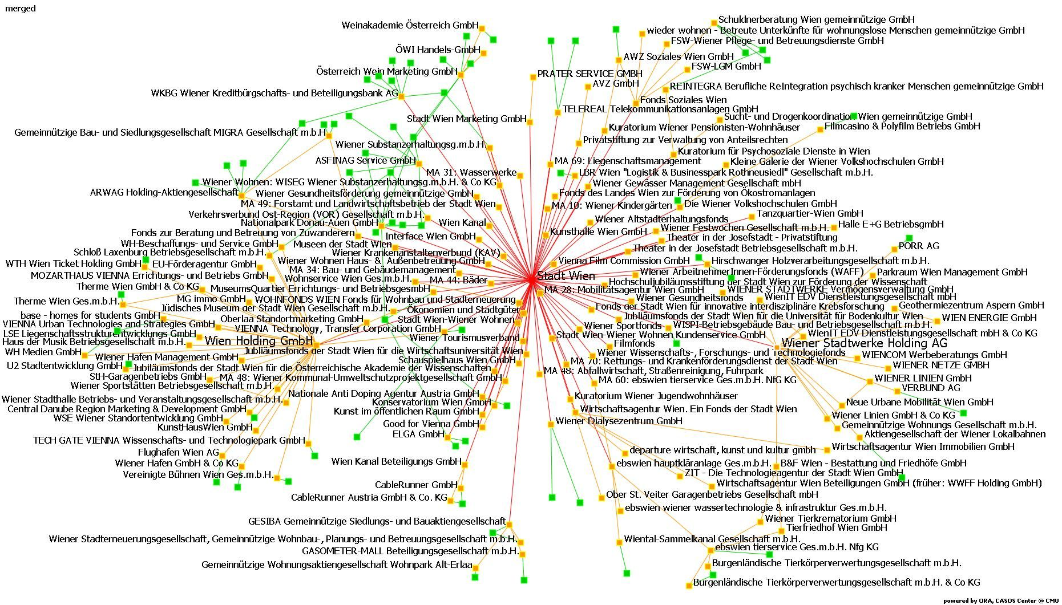
Red Vienna: Beyond „housing“ the many
Notes:
„Red Vienna“ is mostly know for its reforms during the 1920 and particularly for the achievements in „housing the many“ in the so called Gemeindebau. What is less known is that the foundations for the progressive reforms of Red Vienna were laid by the conservatives. In particularly, the conservative major Karl Luegger did develop much of the technical infastructure, including the municipalication of gas works and electricity works, as well as the foundation of the municipal saving bank.
The merit of Viennese social democrats after WWII was that they succeded to maintain and develop the strucutres beyond the well know story of „housing the many“. So, not only is Vienna a specific case of decommodified housing with around 220.000 municipal units, but it is also involved in a number of fields from the „cradle to the grave“.
As you can see in this network figure the city of Vienna disposes of a complex set of institutions. By the end of 2016 there were at least 245 direct an indirect participations.
Two key levers for city government and the administration to deliver on foundational needs are highlighted by red rectangles:
Wiener Stadtwerke Holding AG and Wien Holding.
The former runs public transport, local energy and gas networks and manages funerals and cimeteries. The latter is a key player in managing various museums, sports & recreational facilties, develops real estate and runs the local port and water transports.
In total, the City of Vienna employs around 60.000 people – around 16.000 are working for the Stadtwerke alone.

Slide 12
Red Vienna: Social-Ecological Infrastructure
Relatively high level of output legitimation → delivering for the many (see city rankings)
But lacking input legitimation → „Left Josephines“ (Egon Matzner)
Looking towards other cities that open up to the citizenry → experimentalist governance, e.g. Grenoble, Barcelona, Amsterdam
1 / 231 | Quality of Living Survey 2018 (Mercer)
1 /87 | Smart City Index (Roland Berger)
2 / 140 | The EIU Livability Survey 2017 (EIU)
2 / 25 | Most liveable city Index 2017 (Monocle)
3 / 55 | World’s Most Reputable Cities 2017 (Reputation Institute)
10 / 500 | Innovation Cities Index 2016/17 (2thinknow)
14 / 42 | Global Power City Index 2017 (Mori Foundation)
1 / 69 | State Of The World Cities 2012/2013 (UNO)
Notes:
As you may know this complex web of institutions is delivering for the many. At least if you believe the various city rankings
Hence, generally its safe to say that Vienna is having a good quality of life for many people. More importantly, Vienna can be conceived as a role model for promoting a social-ecological transition throught its collectively provided partly decommodified infrastructure.
However, the city does not fare well when it comes to involvement of citizens in various domains of its institutions. This relates to what Andreas has said about Austrian and Viennese tradition of a statist, top-down tradition with limited citizen involvement. While Vienna does care for the many it does so in a paternalistic style. This has led Egon Matzner, the founding father of our institute and an outstanding social democratic thinker to label the viennese social democrats as „Left Josehpines“.
Against this background, progressive critics are looking towards other cities that open up to the citizenry e.g. Grenoble, Spanish cities like Barcelona, Amsterdam (We make the city) – which are potential sites of learing for experimentalist governance.

