Slide 1
New place based policies (for Morriston)?
Jill Ebrey for Manchester University
Ross Williams for Coastal Housing

Slide 2
How place based policy can be more specific and participative
Standard government policy is generic + top down: same policies everywhere ( improve transport and upskill) + done to and for people
We are beginning to think about doing policy differently:
To understand more about specific places; start by challenging problem definitions + exploring alternatives
To develop and borrow tools for doing policy with people/ by people
In Morriston, 3 miles from Swansea centre which in images is everyday Woodfield St + Tabernacle Chapel Grade 1 listed

Slide 3
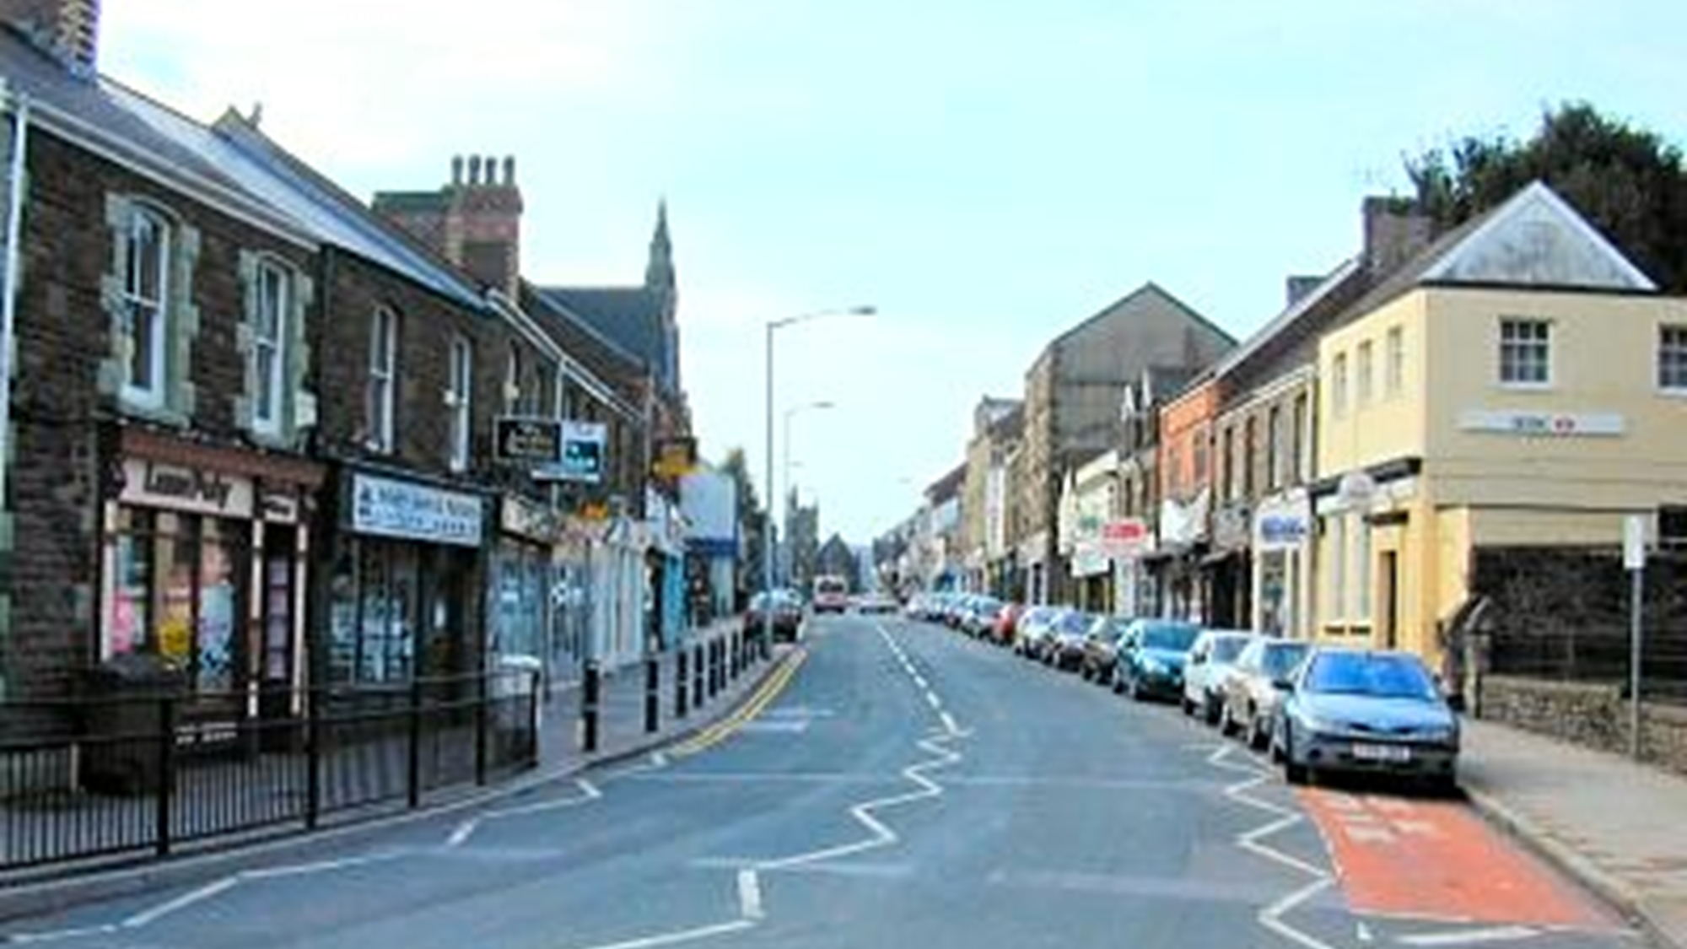

Slide 4
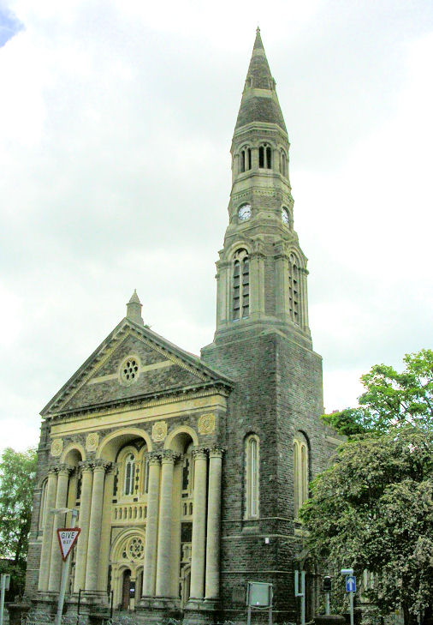
Morriston in images
Woodfield St = a mile long local high street which has suffered from out of town/ big box retail in Llansamlet
Wales’ largest Congregational chapel with a very small congregation
Moriston hospital, DVLA as major employers

Slide 5
But what’s the story in Morriston?
University of Manchester has looked at how Morriston is doing

Slide 6
Standard problem definition:
“left behind” Morriston low GVA + not responding to standard policies
On the standard measures, looking at 2018 and back over the past decade or more:
GVA per capita in Morriston is in line with Swansea but well behind “ successful” high income districts of UK s
Pockets of extreme deprivation 3 of 11 LSOAs in bottom 10% on Welsh multiple deprivation index
Morriston like rest of Wales is not responding to gov policy + improving relatively/ closing the GVA gap; policy is complicated by residualisation of deprivation eg car adaptation so nearly half never use the bus
If you carry on with standard policies, don’t expect much standard success at Morriston

Slide 7
Worse: upcoming challenges in Morriston needs new econ. base
Without buying into GVA problem, Morriston faces challenges over the next 15 years:
Collapse of local demand: deindustrialisation was buffered because the factories closed but left behind their DB pensioners: 18 % of Morriston residents are over 65 + probably account for 25% plus of local spend
Disorderly retreat on the supply side: shopping will migrate on line stripping out retail . Swansea has 10% of workforce in retail and Morriston is doubly vulnerable with small traders on Woodfield St and big box in Llandsamlet
Morriston needs preventive policies to construct a different business and activity base; Woodfield St needs regen like Swansea High St

Slide 8
Better:
“most attractive place to live and work in Wales” needs social infrastructure
But, other ways to look at a place
CEBR consultants in 2015 found Morriston was “the most attractive place to live and work In Wales” ahead of Penarth; ex high employment, short travel to work + affordable housing (average income related to house price)
Most are comfortable (eg U of M quaire on home heating or buying food) but asking for social infrastructure ie free or low cost activities that enrich social lives
As one respondent pointed out, ‘Things can’t improve if people/the council won’t invest in the area and make it an attractive place to visit.’
Another resident made some suggestions, (We need) something for older kids to do e.g. basketball courts, more parks for young kids and more community centres for mums and tots and for people to make friends…’
JMorriston needs new policies for social infrastructure (standard policy has been preoccupied with econ infrastructure)

Slide 9
Pulling it all together: new place based policies for Morriston
If existing WG and LA policies will not deliver very much by their own criteria, Morriston needs
new preventive policies to rebuild the business and activity base; if not, retail collapse in 2020s will be as damaging as factory closures from 1980s; property based regen and look towards the Hospital and DVLA in but not of Morriston
less top down policy in foundational sectors where users are a minority; eg local public transport when nearly half do not use the bus; relevant policy has to be negotiated with users and legitimated by community
new policies to build social infrastructure and civic life; library is already a major reason for visiting Woodfield St; making “the economy” work is both more difficult and less important than making society work
The common thread is community involvement

Slide 10
What Coastal can co–produce in Morriston
Coastal Housing is broadening its expertise with ABCD

Slide 11
Asset Based Community Development (ABCD): A new approach for Coastal
An approach which ‘allows communities to drive the development process’
Not for everyone
Has to be supported by other things
Enabling the ‘by’ space
‘Discovery’ before ‘Delivery’
‘Contact’ before ‘Content’
‘Strong’ not ‘Wrong’

Slide 12
What Coastal is doing:
Co-operative relationship with Vanguard – whole system approach
Learning from work on High St
Using expertise in property based regeneration
Tapping into the ‘Associational Life’
Understanding and mapping what it ‘has’, before we discuss what it ‘needs’ with the community

Slide 13
What ABCD offers?
Not new. But arguably bolder.
Learning as we go. Offers a modesty to the community.
Creates a space for ‘active citizenship’. Shift from organisations seeing itself as ‘experts’ and more of an ‘enabler’ or ‘collaborator
A constructive emphasis on ‘assets’ allows for a different conversation
Bottom up, and with community empowered, can see a flexible, adaptable response.
Offers an evidence base to top-down policy

Slide 14
Headlines so far: not yet at the end of the beginning
Early days - ‘Speed of trust’
Understanding ‘What Matters’ to traders and local community
Mobilised a small group of community connectors
Connecting traders with each other and those in other towns to challenge assumptions
Not doing everything; relying on expertise and resources elsewhere (Local Authority, Welsh Government)
Bottom up approach has created a space for engagement

