Slide 1


TOWARDS A FOUNDATIONAL STRATEGY FOR BARCELONA
LOCAL IDENTITY
METROPOLITAN COMMITMENT
GLOBAL VISION
@pembarcelona
September 2019

Slide 2
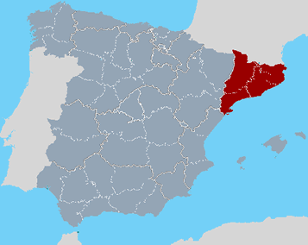
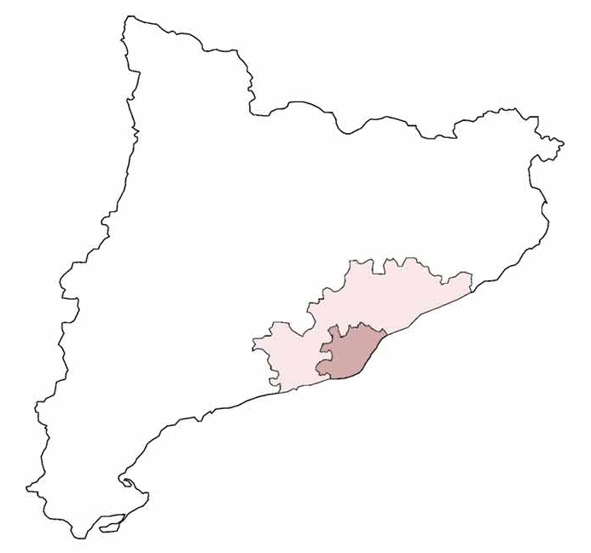
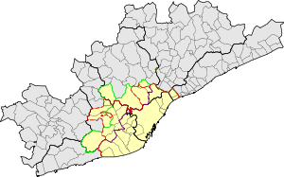
METROPOLITAN BARCELONA
RMB: Metropolitan Region
(no formal institution)
5,073,993 inhab. (2017)
164 municipalities
3.231 km²
AMB: Metropolitan Area
(formal institution)
3,262,065 inhab. (2017)
36 municipalities
628 km²

Slide 3
30 YEARS OF STRATEGIC PLANNING

Slide 4
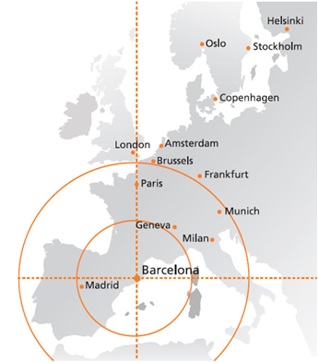
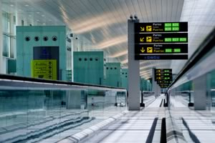

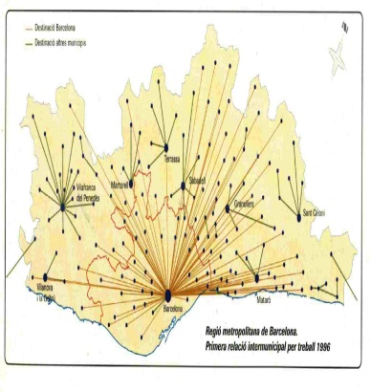
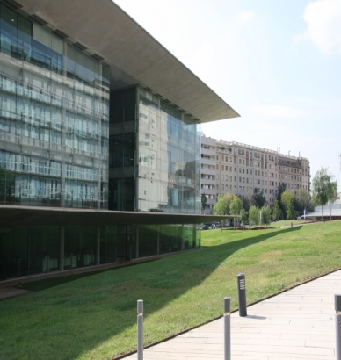
THE EVOLUTION OF BARCELONA’S STRATEGIC VISION
1990-93
City in the global map
1994-98
Interna-tional City
1999-03
Knowledge City
2004-09
Metropoli-tan City
2010-15
Attractive City for Innovative Talent
1st Metropolitan Plan
Bcn Vision 2020
1st City Plan
2nd City Plan
3rd City Plan
Evolution of the strategy and the main objectives in each plan.

Slide 5
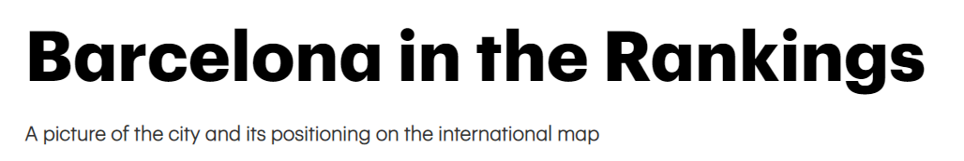


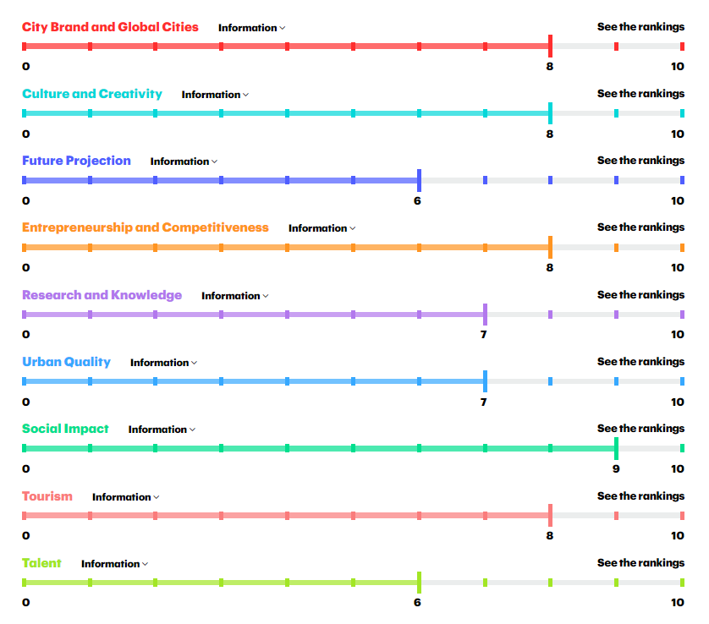

Slide 6
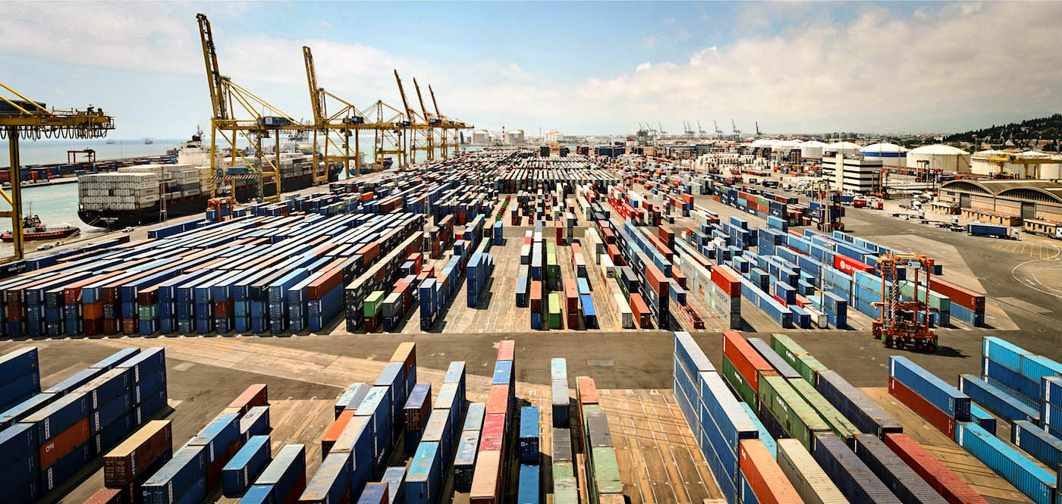
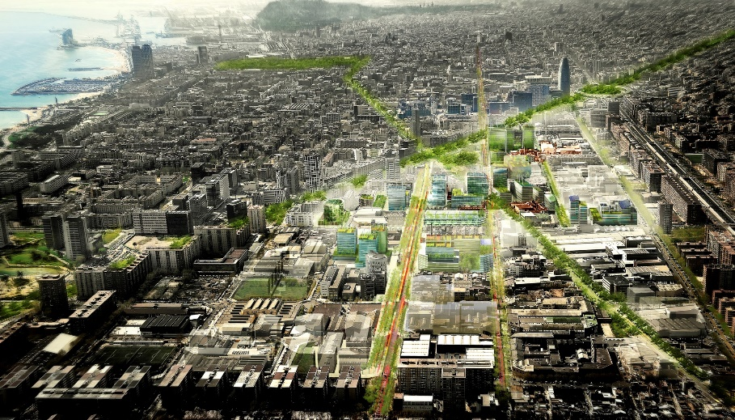
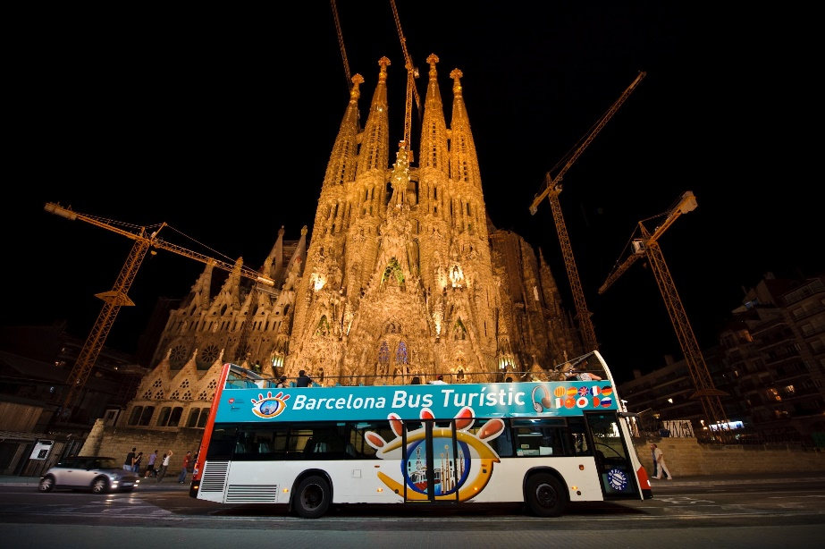
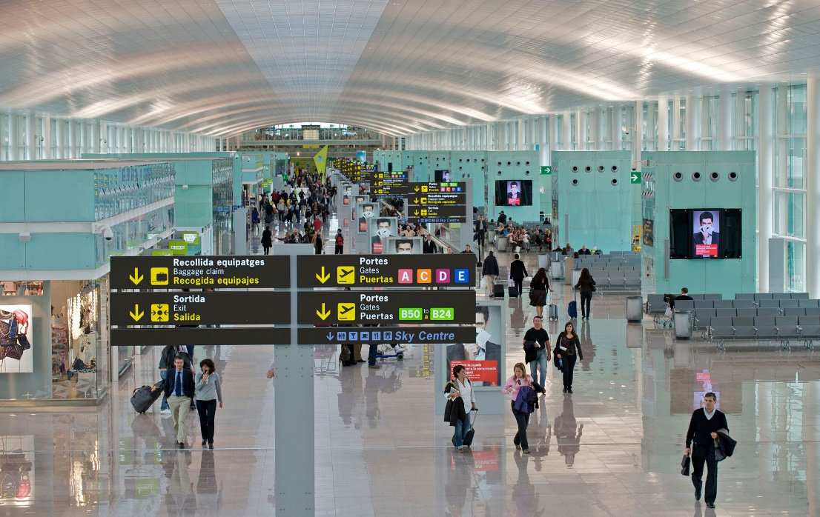
THE DIFFERENT FACES OF SUCCESS

Slide 7
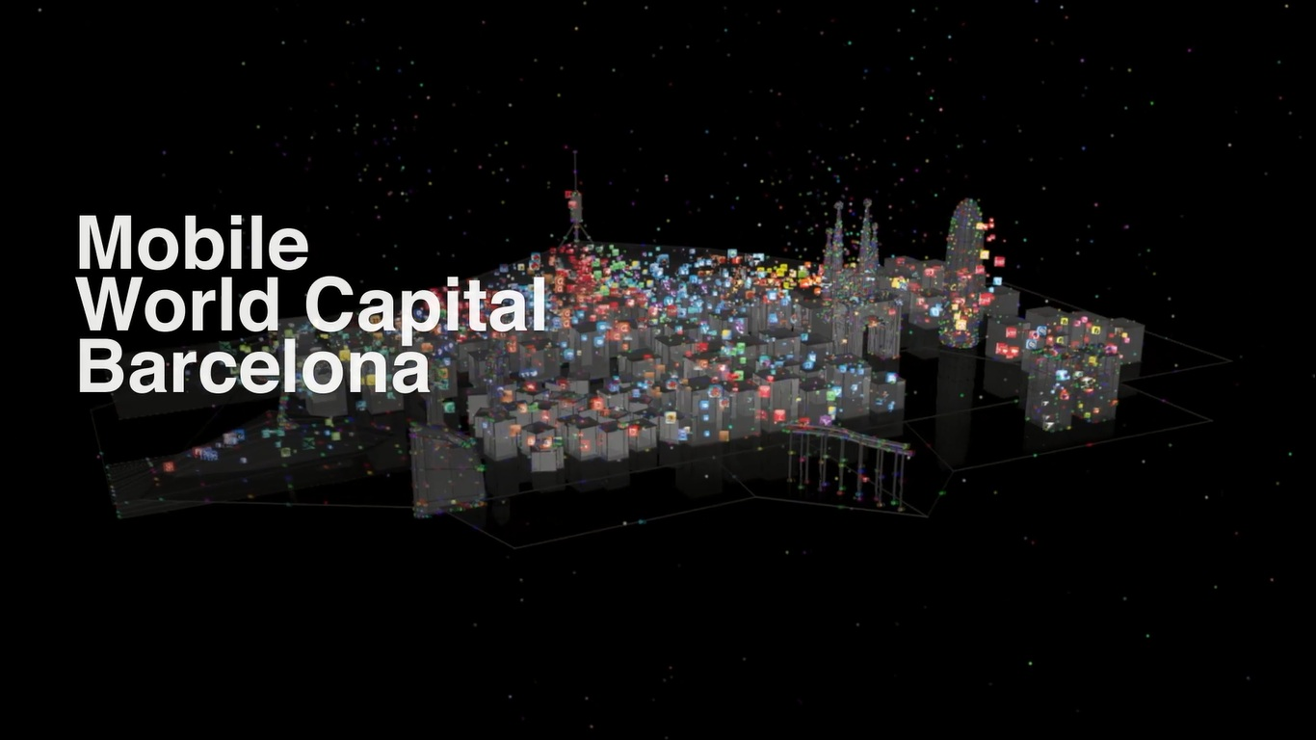
THE DIFFERENT FACES OF SUCCESS

Slide 8
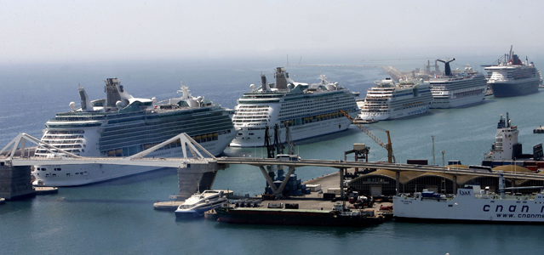
THE DIFFERENT FACES OF SUCCESS

Slide 9
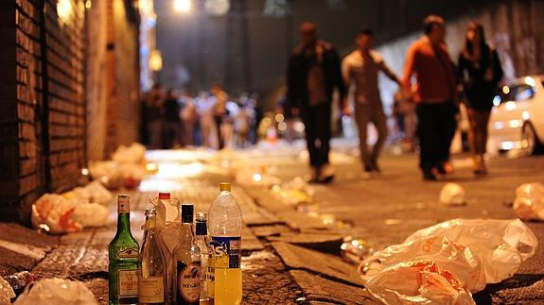
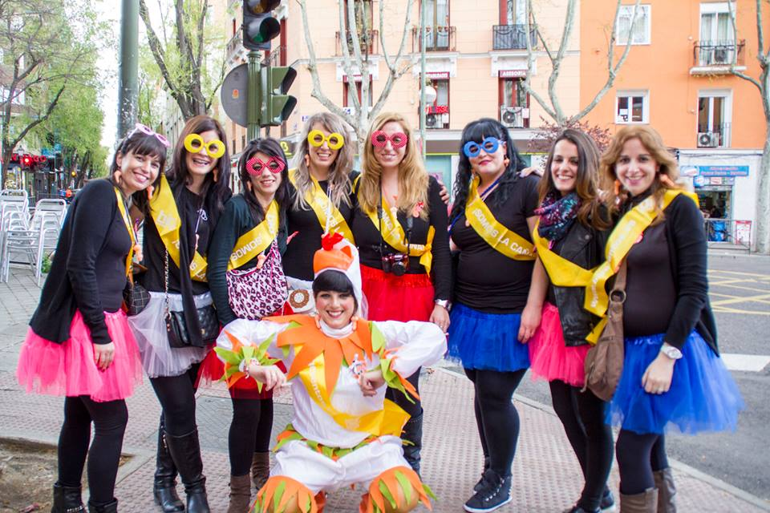
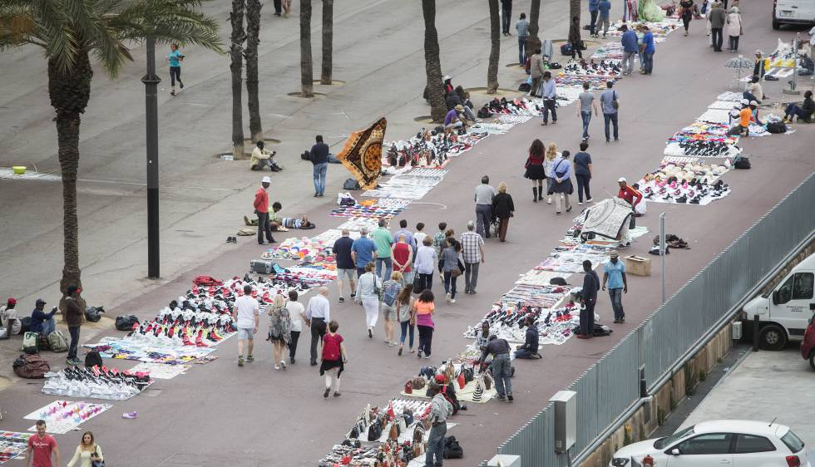
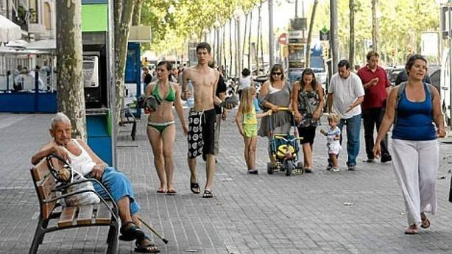
THE DIFFERENT FACES OF SUCCESS

Slide 10
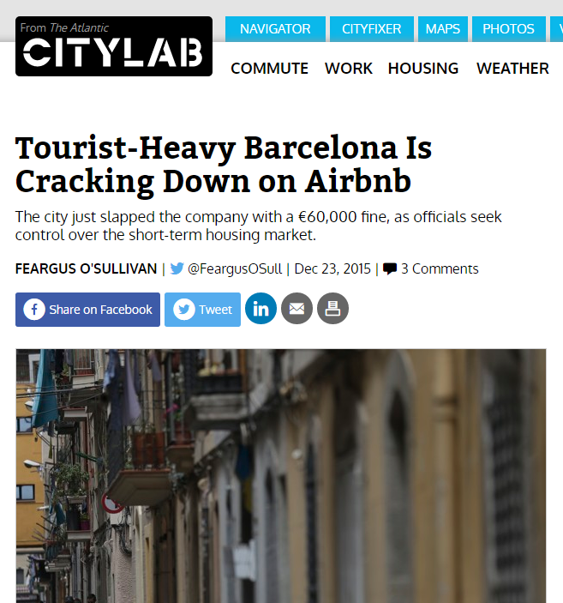

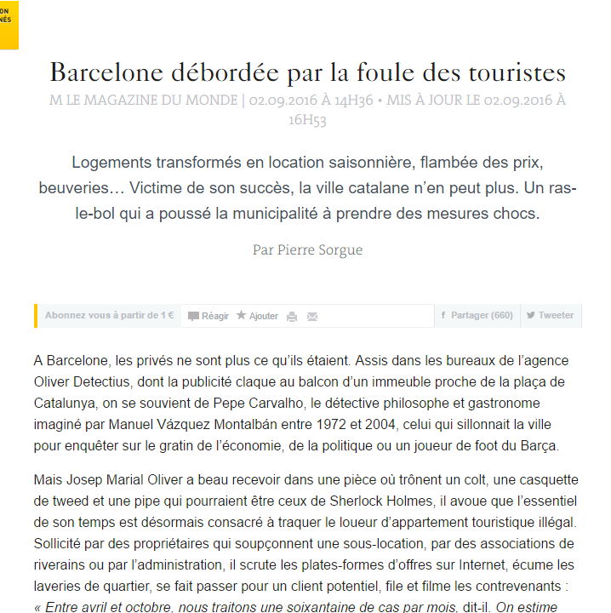
THE DIFFERENT FACES OF SUCCESS

Slide 11
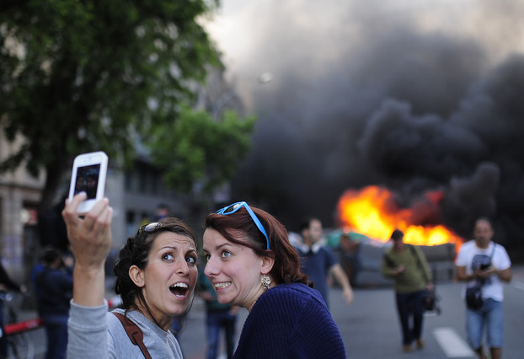
THE DIFFERENT FACES OF SUCCESS

Slide 12
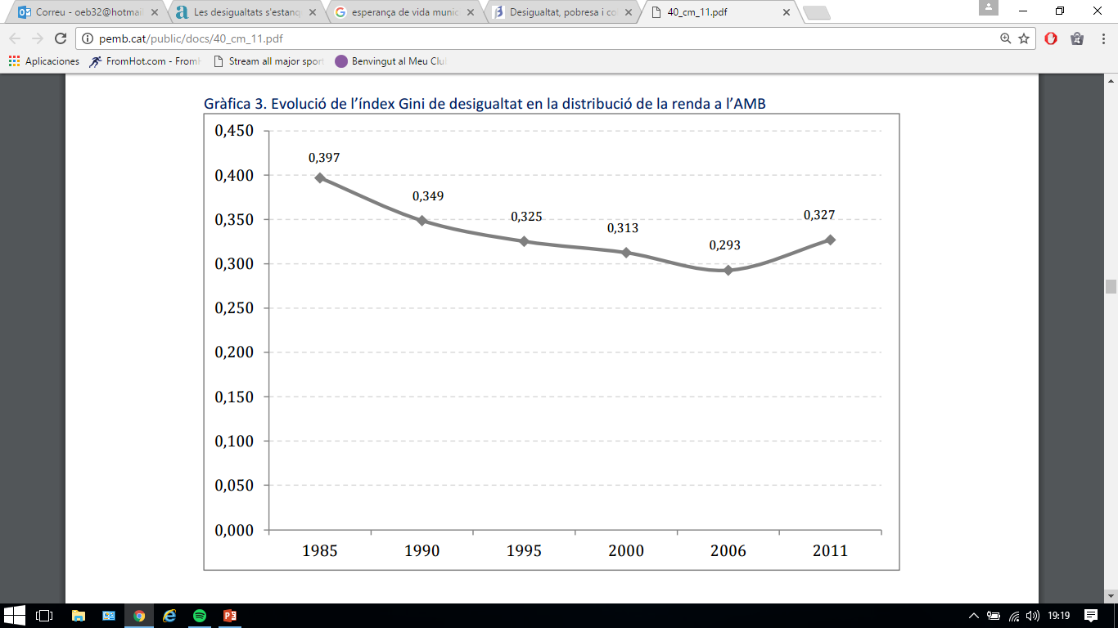
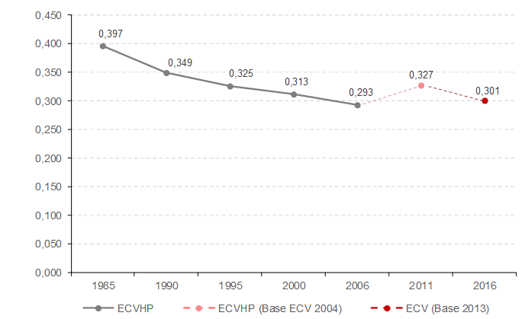
INEQUALITY (Income: Gini Index)
Sarasa, S. (2014): Desigualtat, pobresa i cohesió social. Paper de treball Pla 2025
http://pemb.cat/public/docs/40_cm_11.pdf, actualitzat per l’IERMB amd dades ECV 2016 (Idescat)

Slide 13
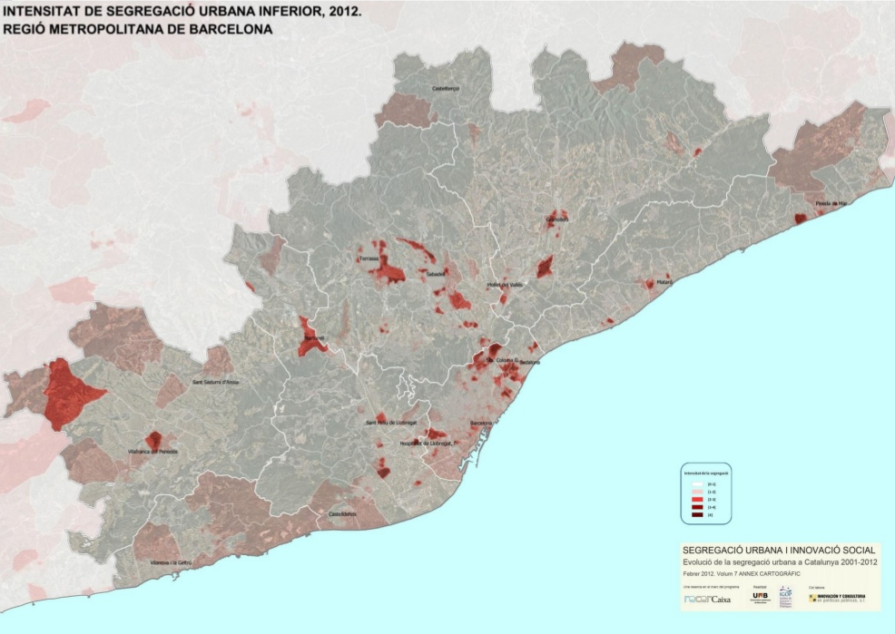
SEGREGATION (Low income)
Nel·lo, O.; Blanco, I. (2015): La segregació urbana a la regió metropolitana de Barcelona. Paper de treball Pla 2025
http://pemb.cat/public/docs/41_lc_12.pdf

Slide 14
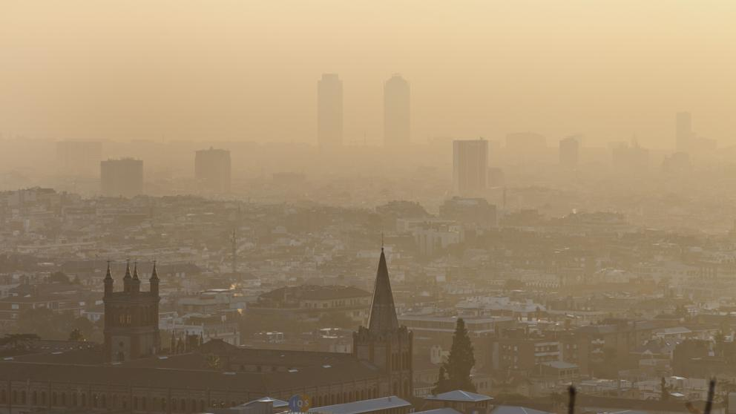
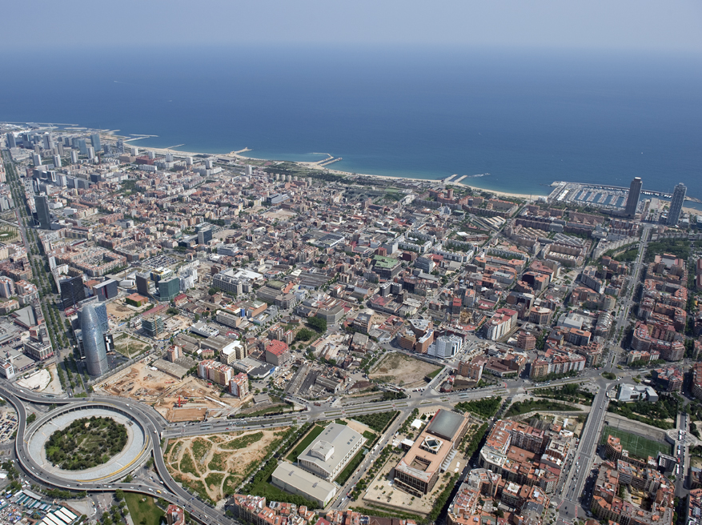
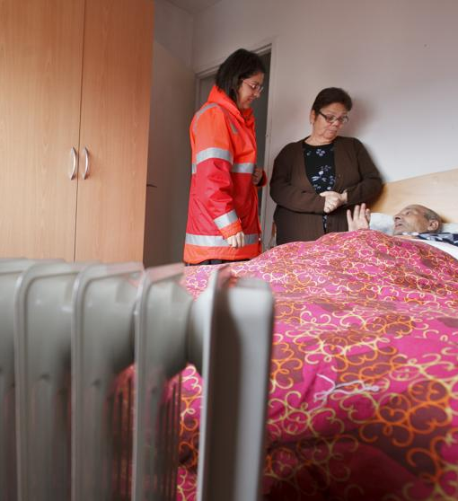
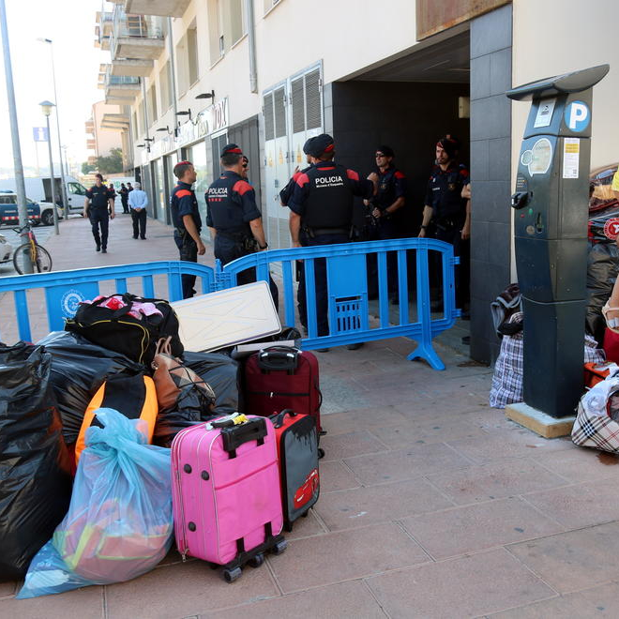
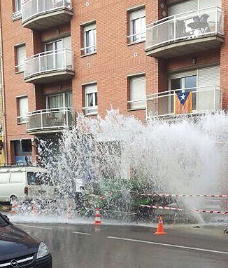


Slide 15
A NEW STRATEGIC PLAN: FOUNDATIONAL STRATEGY

Slide 16
THE NEW MAIN CHALLENGE
To boost social and economic progress to reduce metropolitan inequalities and urban segregation through innovation and sustainability

Slide 17
MAIN PILLARS OF THE STRATEGY
RESILIENCE
BASIC NEEDS
(FOUNDATIONAL)
PROSPERITY
COHESION
OPPORTUNITIES
SOCIAL JUSTICE

Slide 18




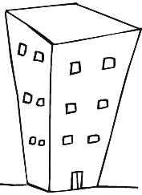
RESILIENCE ELEMENTS
Strategies to meet basic needs for all, everywhere and at all times
Air
Water
Energy
Housing
Food

Slide 19
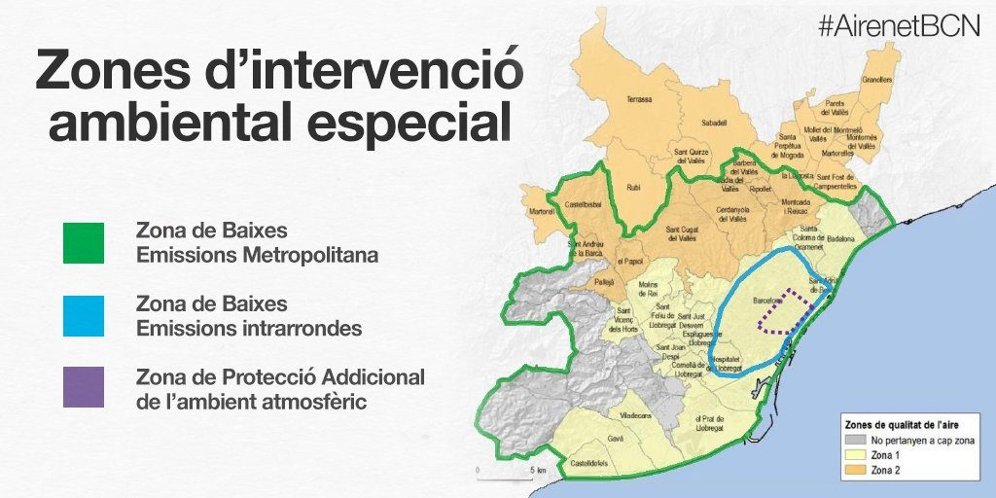

Slide 20
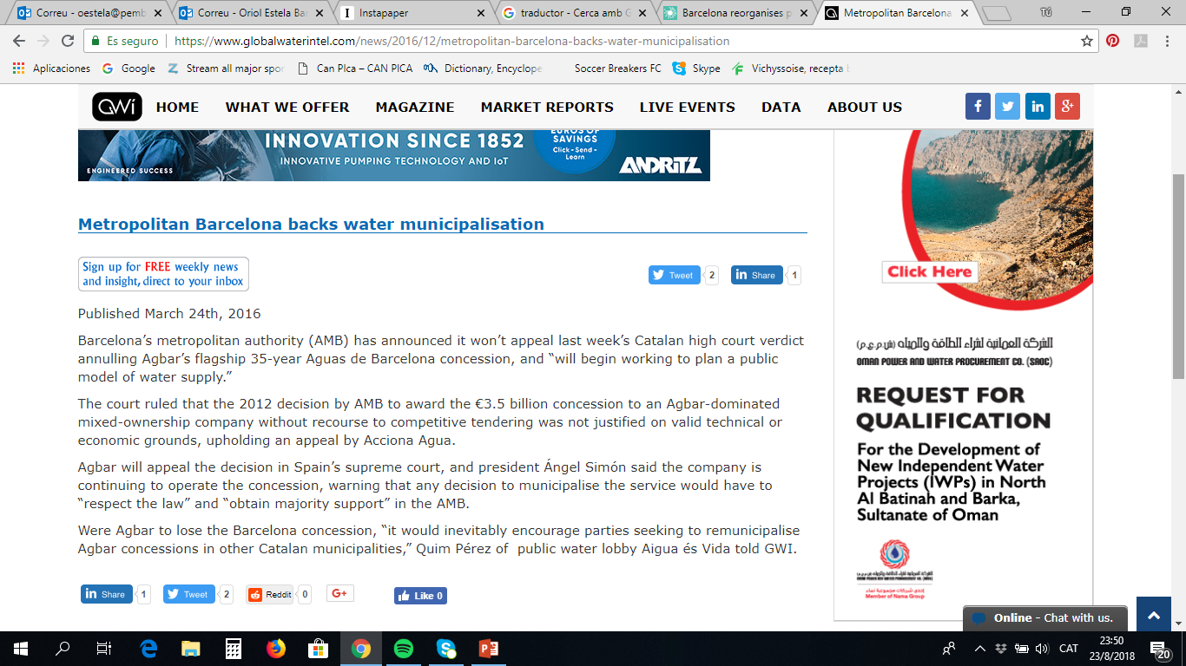
05/11/2017
AGBAR would claim € 1bn to Barcelona in case of municipalisation. The company estimates that the City Council and the Metropolitan Area should compensate for a possible cancellation of the supply contract with 470 million for the assets and 500 for loss of profit

Slide 21

02/07/2018
Barcelona Energía, the public commercialiser of electric power, begins operating in the electricity market
From February 1, it manages 45 MW of public power generation, equivalent to around 200,000 MWh of green and local energy
The public commercialiser of electric power is a priority of the Municipal Government as an instrument for the promotion and stimulation of local and renewable energy generation both at the level of municipal facilities and also for citizens

Slide 22
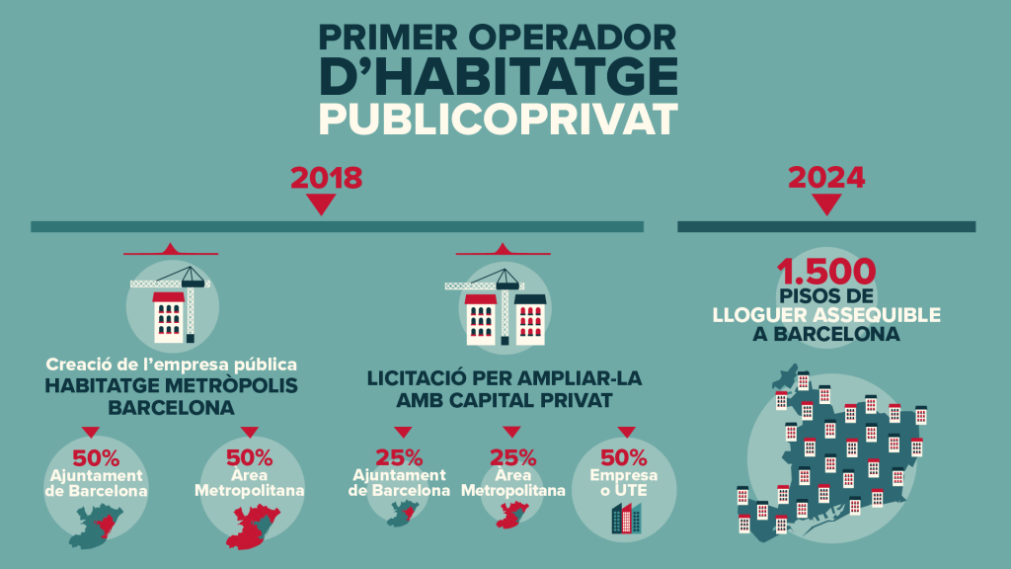
03/23/2018
The creation of a public-private metropolitan operator for affordable rent housing advances as planned.

Slide 23

The Metropolitan Food Charter is the territorial adaptation to metropolitan Barcelona of the Milano Urban Food Policy Pact.

Slide 24
PROSPERITY ELEMENTS
Strategies to boost progress & wellbeing: the best place to live, work and network
Quality urban fabric
Urban innovation clusters
Multipolarity and connectivity
Science, art & creativity in action
Decent work of all types

Slide 25
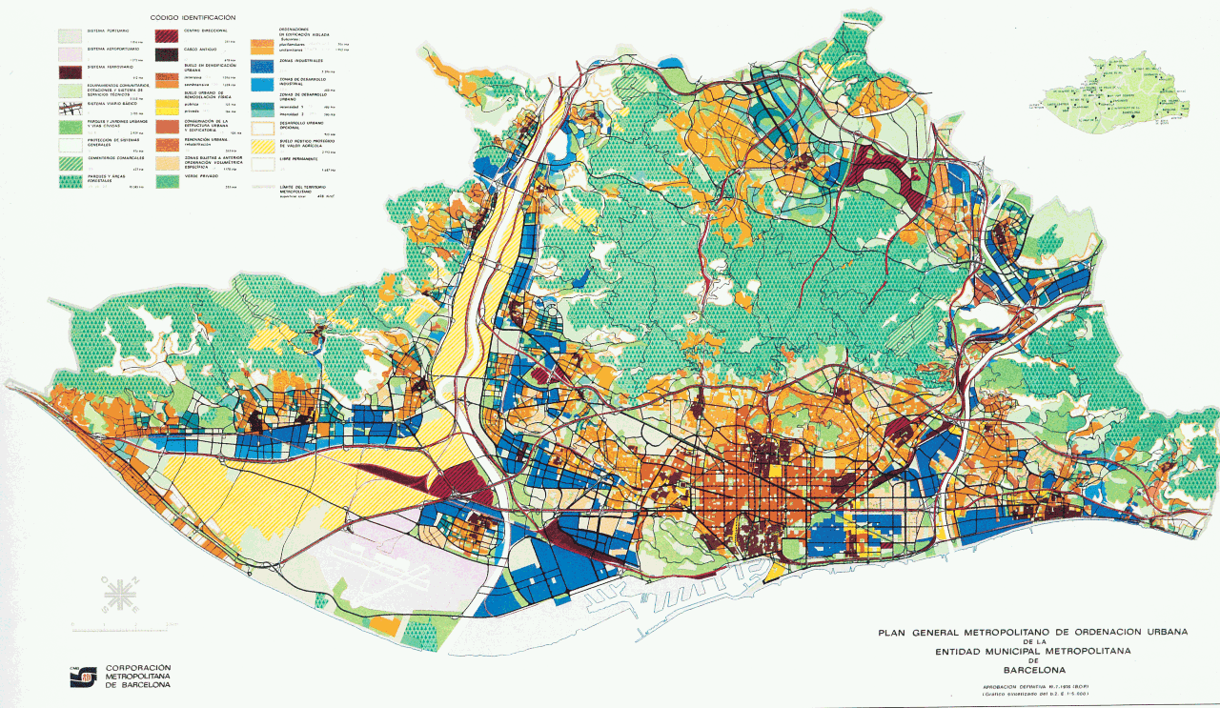

Slide 26
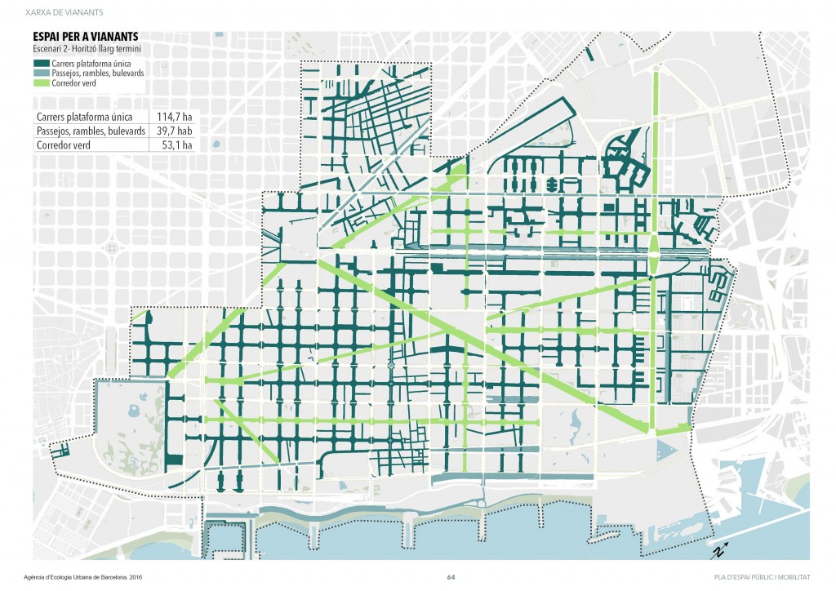
SUPERBLOCKS

Slide 27
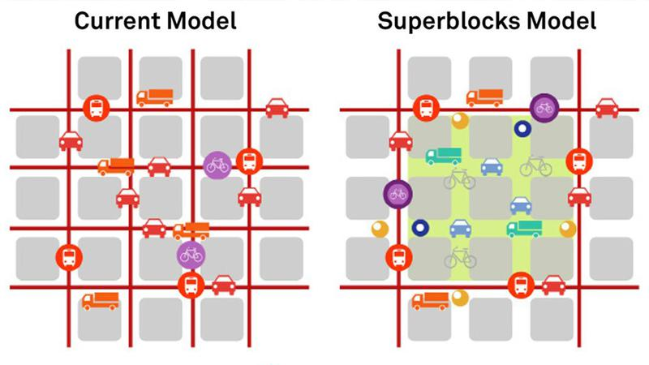
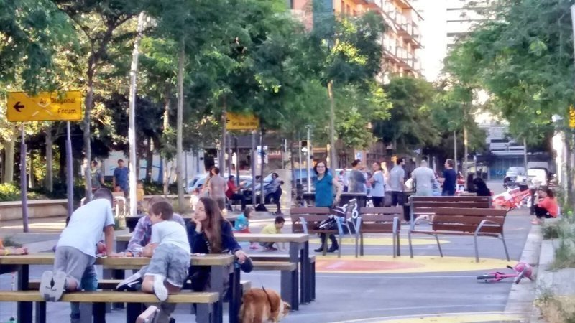

Slide 28

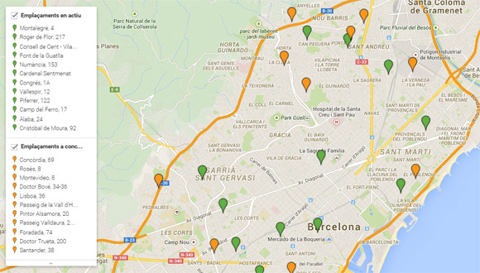

Slide 29
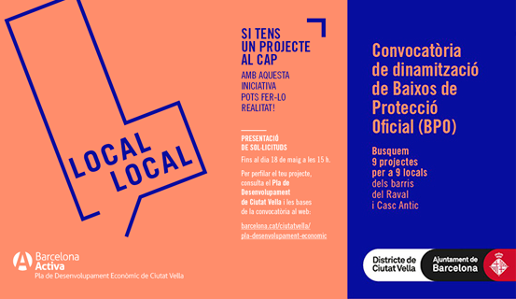

Slide 30


Slide 31


Slide 32
COHESION ELEMENTS
Strategies to strenghten predistribution and redistribution: no one left behind
New metropolitan governance model
New local welfare
Education and training
Plural & diverse economy
From neighborhoods to global metropolis

Slide 33
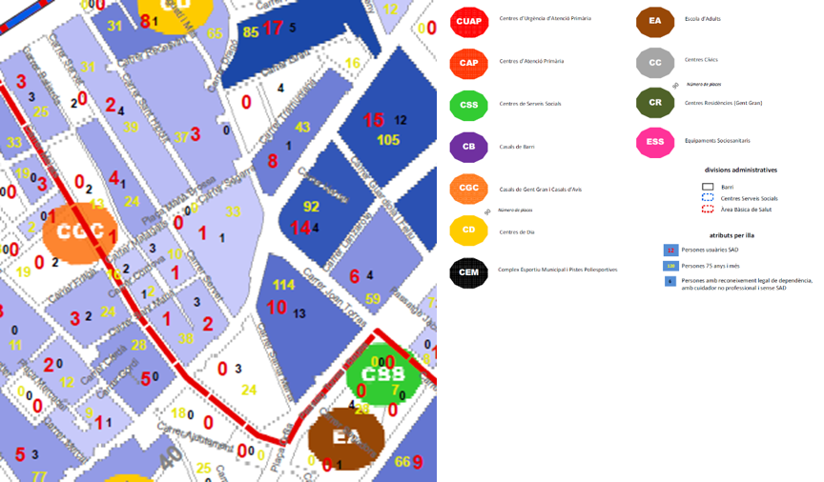
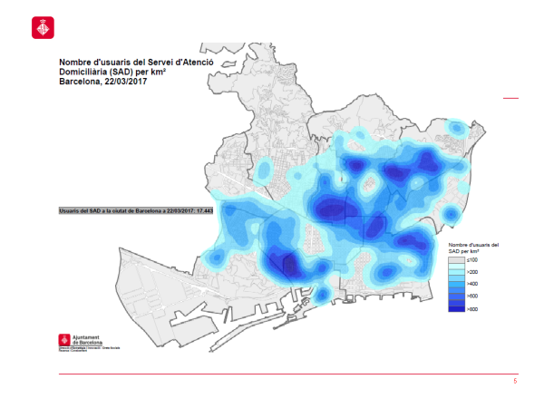
SOCIAL SUPERBLOCKS

Slide 34
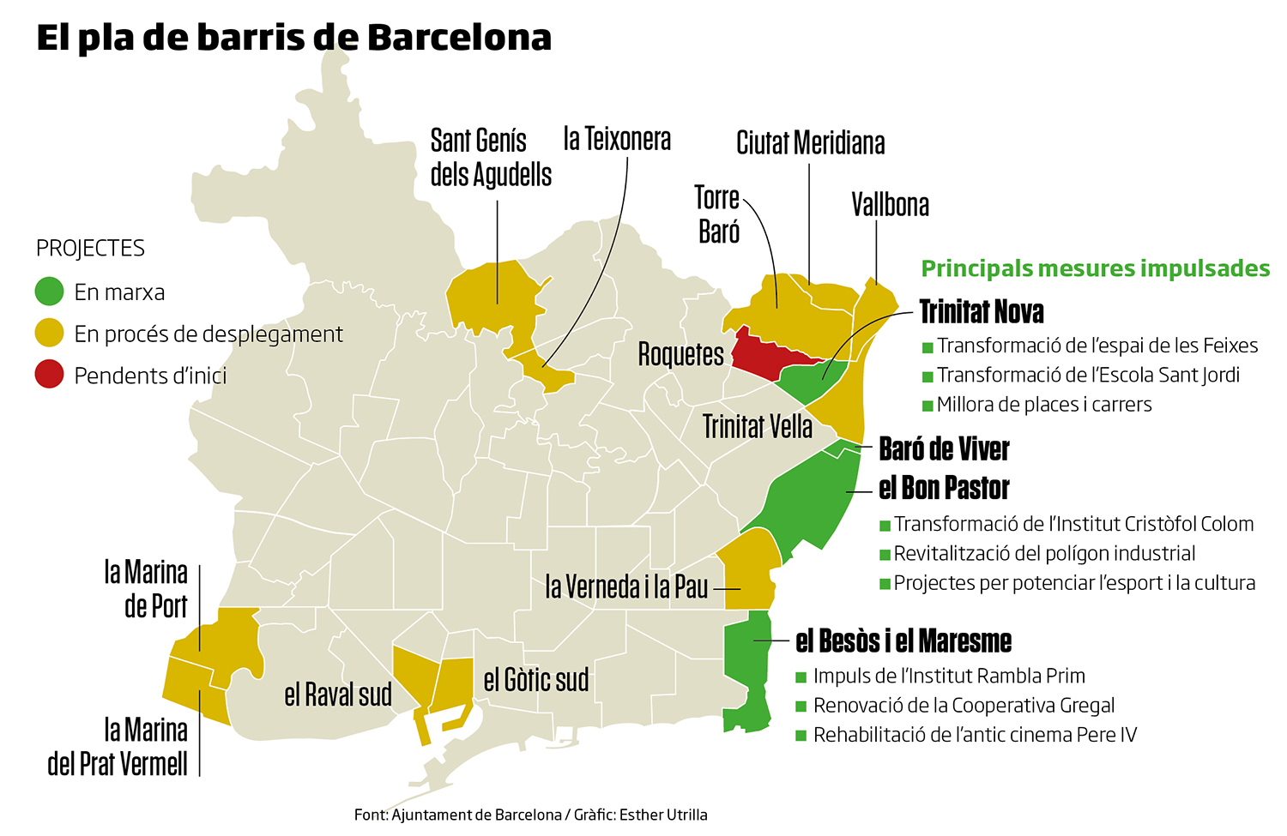

Slide 35
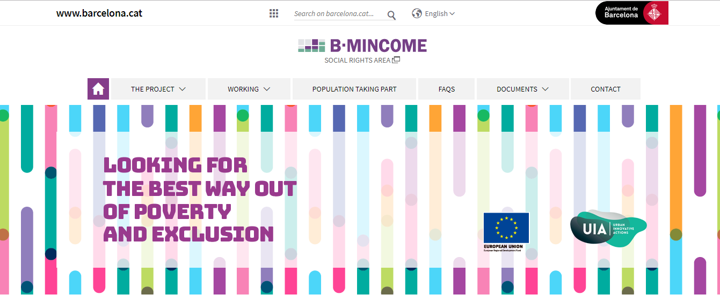
“B-MINCOME is a pilot project for combating poverty and inequality in Barcelona’s deprived areas; It is part of the EU's Urban Innovative Actions programme. The project aims to test the efficiency and effectiveness of combining economic aid, in the form of Municipal Inclusion Support, with active social-employment policies in ten neighborhoods in Barcelona's Eix Besòs area.”

Slide 36


Slide 37
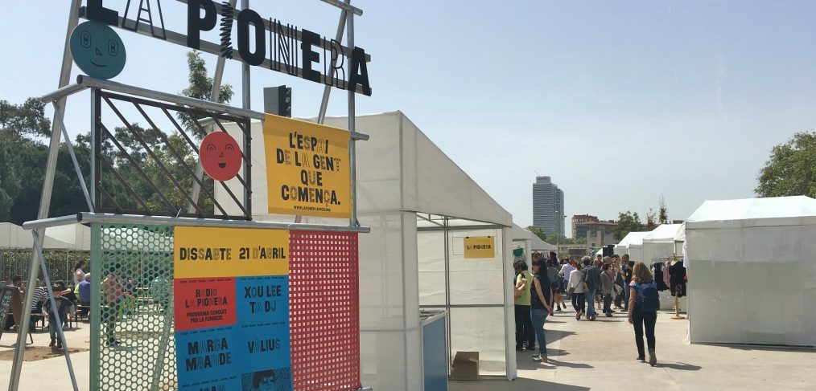

Slide 38
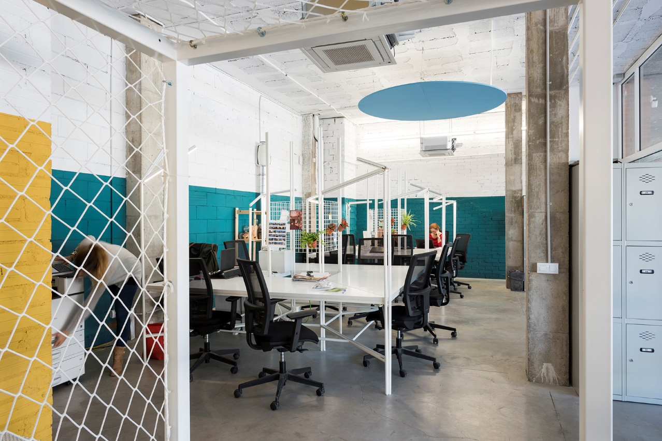


Slide 39
WHAT’S GOING ON NOW?

Slide 40
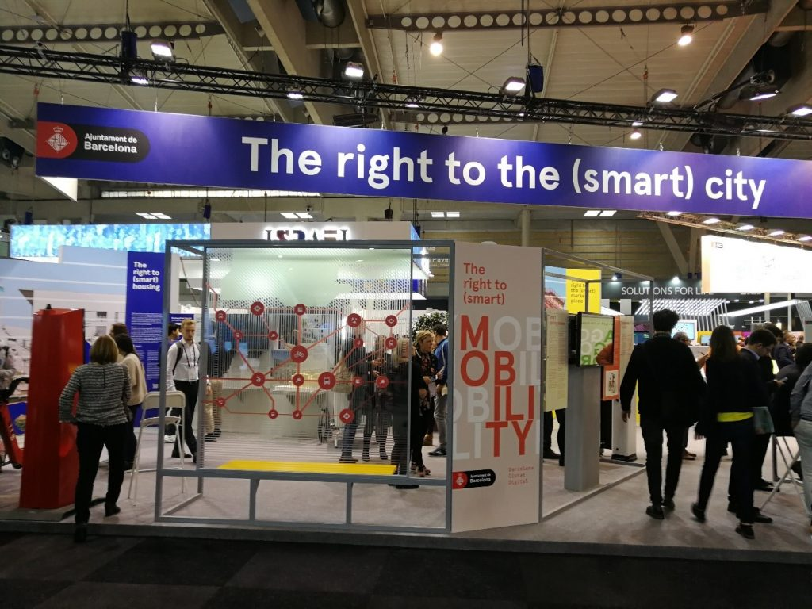
UNDERSTANDING THE NEW FUNDATIONAL

Slide 41
NEW METRICS
GDP is useless (specially at local level)
Happiness measures are ok, but they have no influence on policies (check Brainpool project)
A set of new indicators based on what you consider “The Foundational” is needed:
  . Air quality
  . Water consumption
  . Child obesity vs malnutrition
  . Energy poverty
  . Social Housing
  . Internet Access
Adjusted income
(housing, transport, utilities… costs)
+

Slide 42
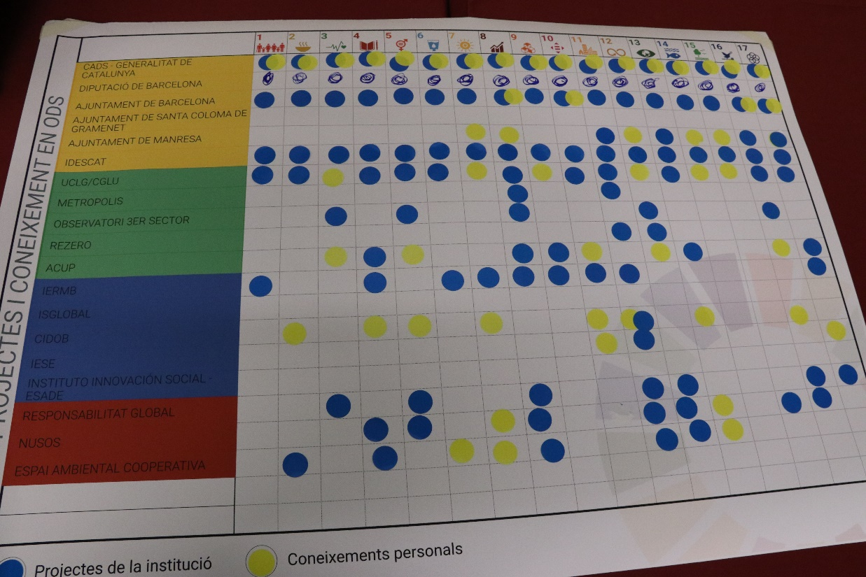
A NEW SET OF STAKEHOLDERS
PUBLIC
ACADEMIA
MEDIA
PRIVATE
CITIZENS

Slide 43
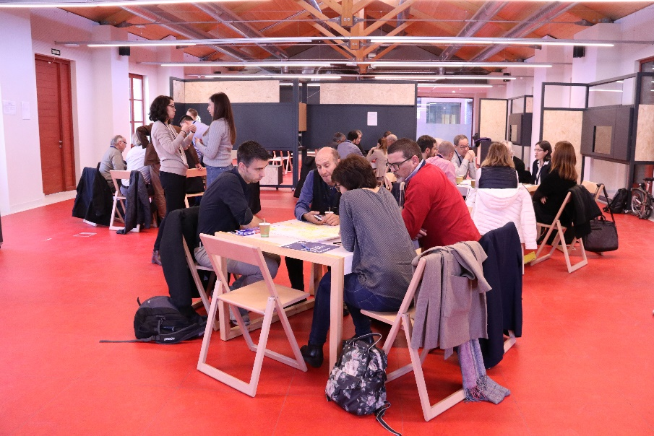
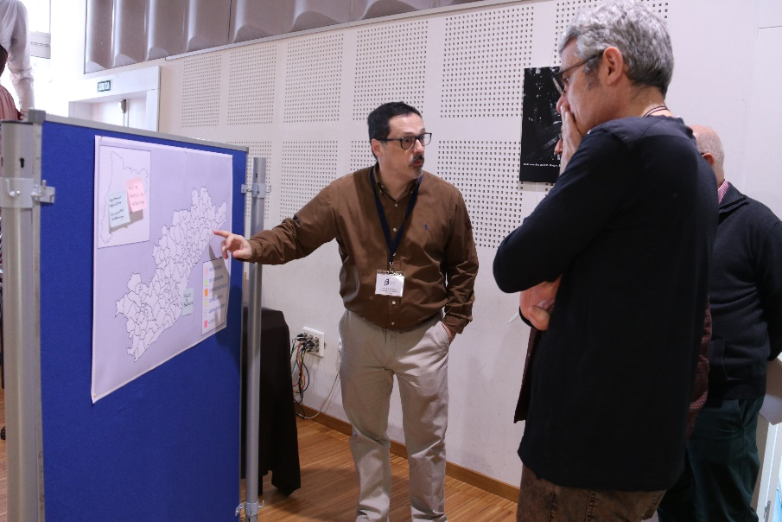

A NEW FUNCTION
Mediators and facilitators replacing “writers”

Slide 44
TOWARDS A FOUNDATIONAL STRATEGY FOR BARCELONA
LOCAL IDENTITY
METROPOLITAN COMMITMENT
GLOBAL VISION
@pembarcelona
September 2019

